Slide 1
Chapter 13: Data Storage Structures

Slide 2
Outline
File Organization
  Fixed-Length Records
  Variable-Length Records
Organization of Records in Files
  Heap File Organization
  Sequential File Organization
  Multitable Clustering File Organization
  Table Partition
Data-Dictionary Storage
Storage Access & Buffer manager
  LRU strategy
  Clock algorithm
Columnar Representation

Slide 3
File Organization
数据库的资源都存储在硬盘中
The database is stored as a collection of files.
Each file is a sequence of records.
A record is a sequence of fields. 一个表存在一个文件里面
One approach:
  assume record size is fixed 长度固定
  each file has records of one particular type only
  different files are used for different relations
This case is easiest to implement; will consider variable length records later.
We assume that records are smaller than a disk block
  .

Slide 4
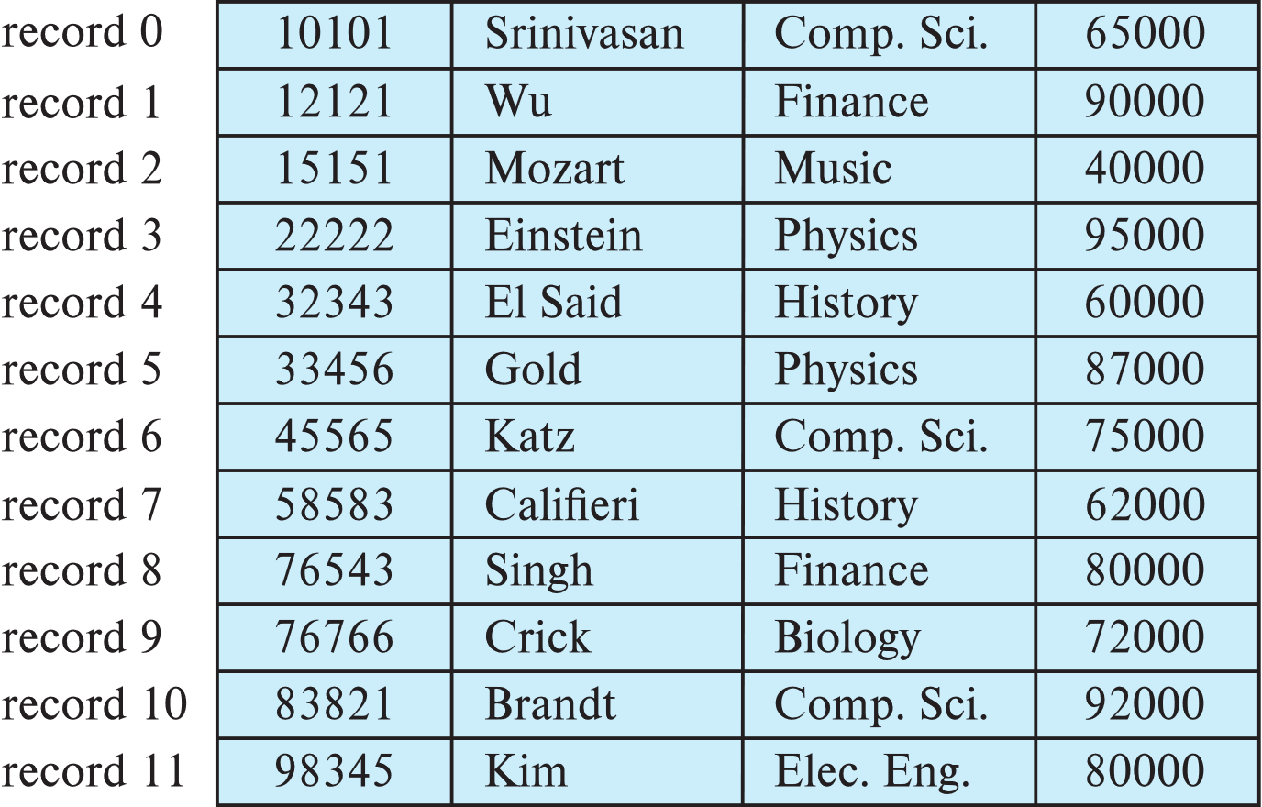
Fixed-Length Records
Simple approach:
  Store record i starting from byte n ∗ (i – 1), where n is the size of each record.
  Record access is simple but records may cross blocks
    Modification: do not allow records to cross block boundaries

Slide 5
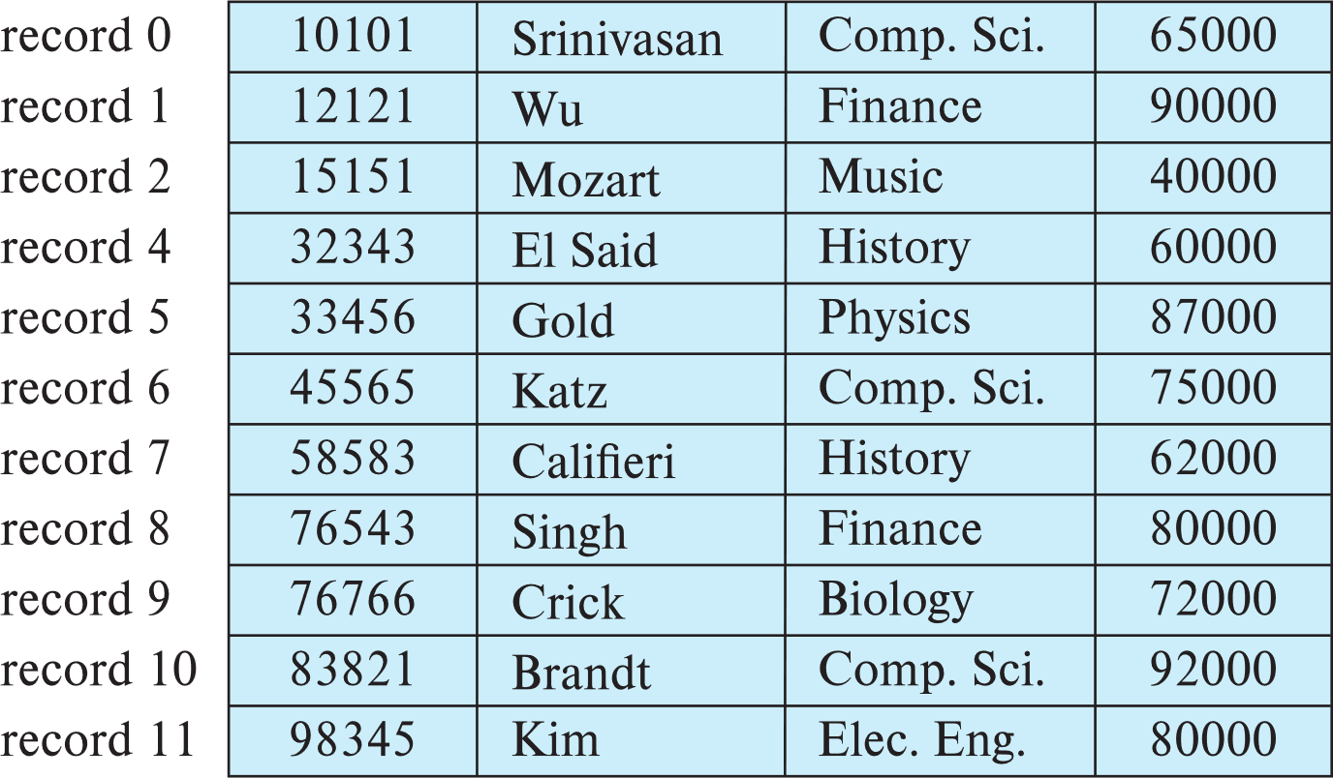
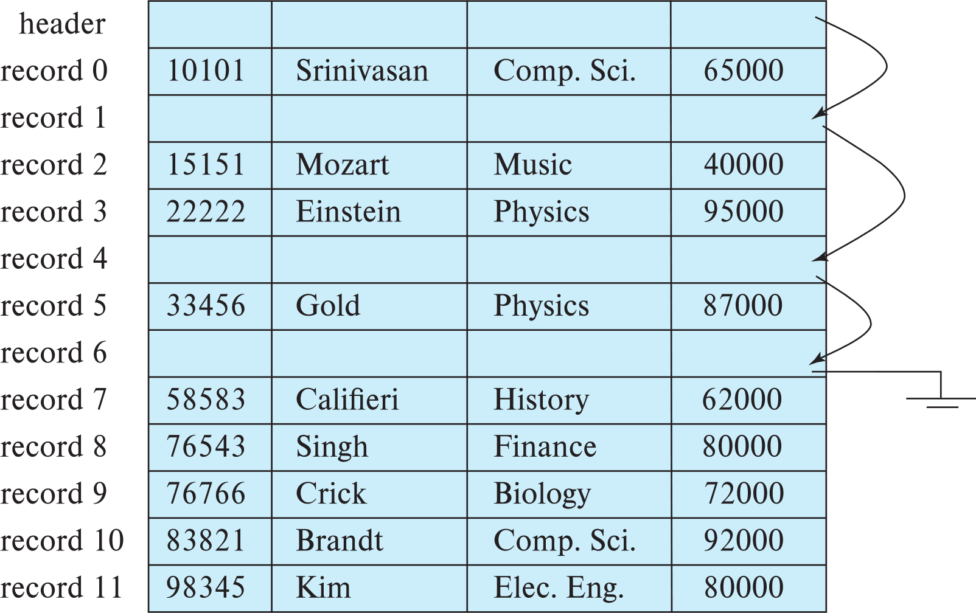
Fixed-Length Records
Deletion of record i: alternatives:
  move records i + 1, . . ., n to i, . . . , n – 1 依次移动
  move record n to i
  do not move records, but link all free records on a free list 虚拟删，只是删掉指针
  Record 3 deleted

Slide 6

Variable-Length Records
Variable-length records arise in database systems in several ways:
  Storage of multiple record types in a file.
  Record types that allow variable lengths for one or more fields such as strings (varchar)
  Record types that allow repeating fields (used in some older data models).
Attributes are stored in order
Variable length attributes represented by fixed size (offset, length), with actual data stored after all fixed length attributes
Null values represented by null-value bitmap（空位图）
Instructor（id，name, dept_name, salary)
定长部分
不定长部分

Slide 7

Variable-Length Records: Slotted Page Structure 分层页
长度
偏移量
Slotted page（分槽页） header contains:
  number of record entries
  end of free space in the block
  location and size of each record
Records can be moved around within a page to keep them contiguous with no empty space between them; entry in the header must be updated.
Record pointers should not point directly to record — instead they should point to the entry for the record in header.
索引： block number+ index

Slide 8
Organization of Records in Files
Heap 堆 – record can be placed anywhere in the file where there is space 有位置就插进去。管理简单
Sequential 顺序– store records in sequential order, based on the value of the search key of each record 管理起来复杂，但是访问会便利一些
In a multitable clustering file organization records of several different relations can be stored in the same file
  Motivation: store related records on the same block to minimize I/O
B+-tree file organization
  Ordered storage even with inserts/deletes
Hashing 哈希 – a hash function computed on search key; the result specifies in which block of the file the record should be placed

Slide 9
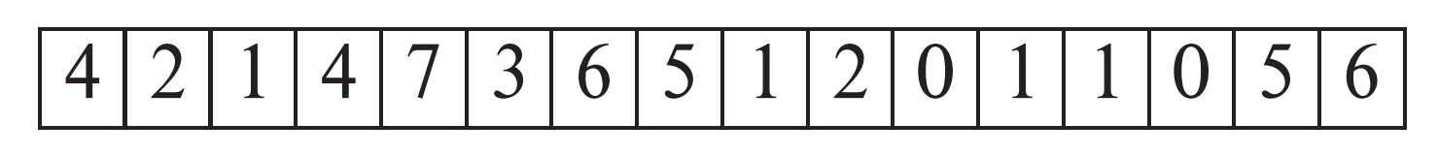
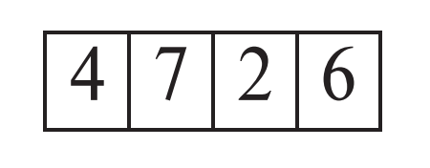
Heap File Organization 堆
Records can be placed anywhere in the file where there is free space
Records usually do not move once allocated
Important to be able to efficiently find free space within file
Free-space map 空闲空间映射
  Array with 1 entry per block. Each entry is a few bits to a byte, and records fraction of block that is free
  In example below, 3 bits per block, value divided by 8 indicates fraction of block that is free
  Can have second-level free-space map
  In example above, each entry stores maximum from 4 entries of first-level free-space map
Free space map written to disk periodically, OK to have wrong (old) values for some entries (will be detected and fixed)
first level
second level

Slide 10

Sequential File Organization
Suitable for applications that require sequential processing of the entire file
The records in the file are ordered by a search-key

Slide 11

Sequential File Organization (Cont.)
Deletion – use pointer chains
Insertion –locate the position where the record is to be inserted
  if there is free space insert there
  if no free space, insert the record in an overflow block
  In either case, pointer chain must be updated
Need to reorganize the file
from time to time to restore
sequential order
如果游离较多，会定期重整

Slide 12



Multitable Clustering File Organization
Store several relations in one file using a multitable clustering file organization多表集群文件组织
department
instructor
multitable clustering
of department and
instructor

Slide 13

Multitable Clustering File Organization (cont.)
good for queries involving join department instructor, and for queries involving one single department and its instructors
bad for queries involving only department
results in variable size records
Can add pointer chains to link records of a particular relation

Slide 14
Table Partitioning
Table partitioning: Records in a relation can be partitioned into smaller relations that are stored separately
E.g., transaction relation may be partitioned into
transaction_2018, transaction_2019, etc.
Queries written on transaction must access records in all partitions
  Unless query has a selection such as year=2019, in which case only one partition in needed
Partitioning
  Reduces costs of some operations such as free space management
  Allows different partitions to be stored on different storage devices
    E.g., transaction partition for current year on SSD, for older years on magnetic disk

Slide 15
Data Dictionary Storage
The Data dictionary (also called system catalog) stores metadata; that is, data about data, such as
Information about relations
  names of relations
  names, types and lengths of attributes of each relation
  names and definitions of views
  integrity constraints
User and accounting information, including passwords
Statistical and descriptive data
  number of tuples in each relation
Physical file organization information
  How relation is stored (sequential/hash/…)
  Physical location of relation
Information about indices

Slide 16

Relational Representation of System Metadata
Relational representation on disk
Specialized data structures designed for efficient access, in memory

Slide 17
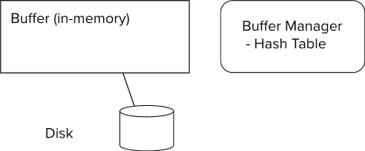
Storage Access
Blocks are units of both storage allocation and data transfer.
Database system seeks to minimize the number of block transfers between the disk and memory. We can reduce the number of disk accesses by keeping as many blocks as possible in main memory.
Buffer – portion of main memory available to store copies of disk blocks.
Buffer manager – subsystem responsible for allocating buffer space in main memory.

Slide 18
Buffer Manager in DBMS
Higher Level Access
Buffer
Main Memory
Database
Disk

Slide 19
Buffer Manager
Programs call on the buffer manager when they need a block from disk.
  If the block is already in the buffer, buffer manager returns the address of the block in main memory
  If the block is not in the buffer, the buffer manager
    Allocates space in the buffer for the block
      Replacing (throwing out) some other block, if required, to make space for the new block.
      Replaced block written back to disk only if it was modified since the most recent time that it was written to/fetched from the disk.
    Reads the block from the disk to the buffer, and returns the address of the block in main memory to requester.

Slide 20
LRU 替换
Supposing there are 4 buffer pages.
Initial is empty occupied。
The access sequence is 1, 4, 8, 1, 5, 2, 3, 2, 4.
According to the LRU policy , there are 3 times replacement occurred.
Access
1 4 8 1 5 2 3 2 4
5
2
3
2
4
8
1
1
5
2
3
2
4
4
8
8
1
5
5
3
1
1
1
4
4
8
1
1
5
Buffer

Slide 21
Buffer Manager
Buffer replacement strategy (details coming up!)
Pinned block: memory block that is not allowed to be written back to disk
  Pin 正在被读写
  Unpin d读写完
  Multiple concurrent pin/unpin operations possible
    Keep a pin count, buffer block can be evicted only if pin count = 0
Shared and exclusive locks on buffer 并发锁
  Needed to prevent concurrent operations from reading page contents as they are moved/reorganized, and to ensure only one move/reorganize at a time
  Readers get shared lock, updates to a block require exclusive lock
  Locking rules:
    Only one process can get exclusive lock at a time
    Shared lock cannot be concurrently with exclusive lock
    Multiple processes may be given shared lock concurrently
    同时读不冲突

Slide 22
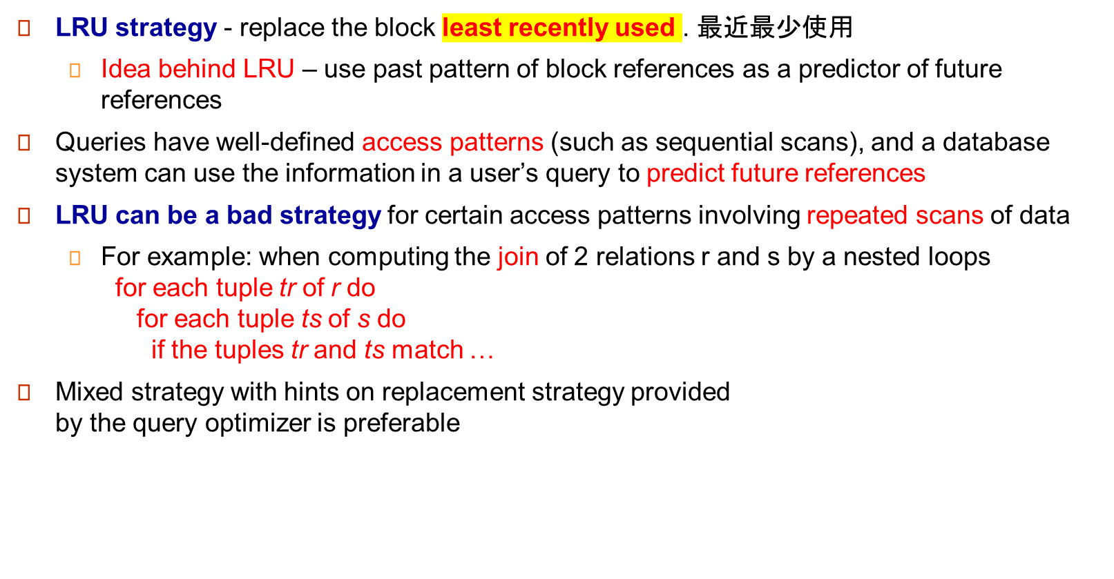
Buffer-Replacement Policies

Slide 23
Buffer-Replacement Policies (Cont.)
Toss-immediate strategy – frees the space occupied by a block as soon as the final tuple of that block has been processed
Most recently used (MRU) strategy – system must pin the block currently being processed. After the final tuple of that block has been processed, the block is unpinned, and it becomes the most recently used block.
Buffer managers also support forced output of blocks for the purpose of recovery

Slide 24
Clock: An approximation近似 of LRU
Arrange block into a cycle, store one reference_bit per block
When pin_count reduces to 0, set reference _bit =1
reference _bit as the 2nd chance bit
0
1
1
0
1
1
1
0

Slide 25
Clock: An approximation of LRU
When replacement necessary
do for each block in cycle {
if (reference_bit ==1)
set reference_bit=0;
else if (reference_bit ==0)
choose this block for replacement;
} until a page is chosen;
0
1
0
走到1置0，走到0替换出去
0
0
1
0
0

